Slide 1
Biomaterials Term Project: Cobalt Chromium Alloys in Partial dental Dentures
Presentation by: Joseph Pitt, Alyanna Harms, Jonathan Terrero

Slide 2
Abstract
CoCr alloys are commonly used in both removable and fixed dentures because they offer high strength, a high elastic modulus, and strong resistance to corrosion.
Their long-term clinical success does not depend on bulk properties alone, but also on how CoCr surfaces interact with opposing natural enamel during everyday oral function (chewing, speaking, sliding contacts).
Compared with other prosthodontic metals like titanium and nickel-chromium, CoCr generally provides a good balance between durability and biocompatibility, making it a frequent material of choice.
However, the surface finish of CoCr prostheses (e.g., polished vs. roughened or different finishing protocols) can substantially affect wear behavior, patient comfort, and overall performance.
This project focuses on evaluating how resistant CoCr is to abrasion against human enamel under different surface finishes and applied forces, to better understand how finishing protocols may influence clinical outcomes.

Slide 3
The Question
For American adults with both permanent and removable partial dentures, does the use of cobalt-chromium reduce the future risk of material degradation?
Alloy Composition & Specifications : Characterization of Co-Cr compositions and their metallurgical properties
Manufacturing Methods: Evolution from traditional casting to modern techniques including CAD/CAM milling and selective laser melting (additive manufacturing)
Clinical Performance: How Co-Cr dentures perform functionally in clinical use (removable and fixed prostheses)
Resist the Oral environment;
  Corrasion Resistance:
  Abrasion Resistance:

Slide 4
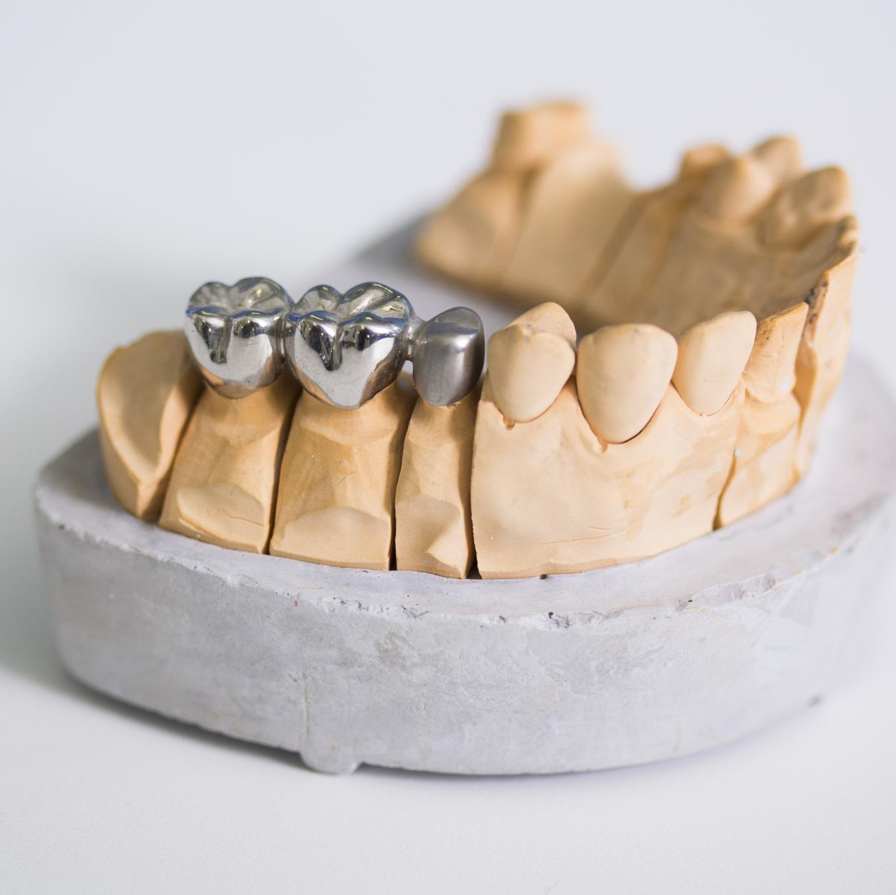
Definitions
Cobalt-Chromium Alloy
  Cobalt-Chromium is popular for dental prostheses due to its high strength, stiffness, biocompatibility, and immunity to wear and corrosion.
Wear and Abrasion Resistance
  Wear resistance means dental materials can withstand chewing or grinding, while abrasion involves surface damage from hard particles or contact.
Corrosion Resistance in Dentistry
  Corrosion resistance keeps materials safe from chemical attacks like saliva and acids, reducing risks of toxicity or allergies in the mouth.
Notes:
Image source: Microsoft 365 content library
CoCr (Cobalt-Chromium) is an alloy used in dental prostheses for its high strength, stiffness, biocompatibility, and resistance to wear and corrosion. Wear resistance refers to a material's ability to withstand mechanical damage from chewing or grinding, essential for restoration longevity. Corrosion resistance describes how materials endure chemical attacks like saliva and acids, preventing toxicity or allergies. Abrasion involves mechanical surface wear from hard particles or contact, affecting the durability of dental restorations.

Slide 5
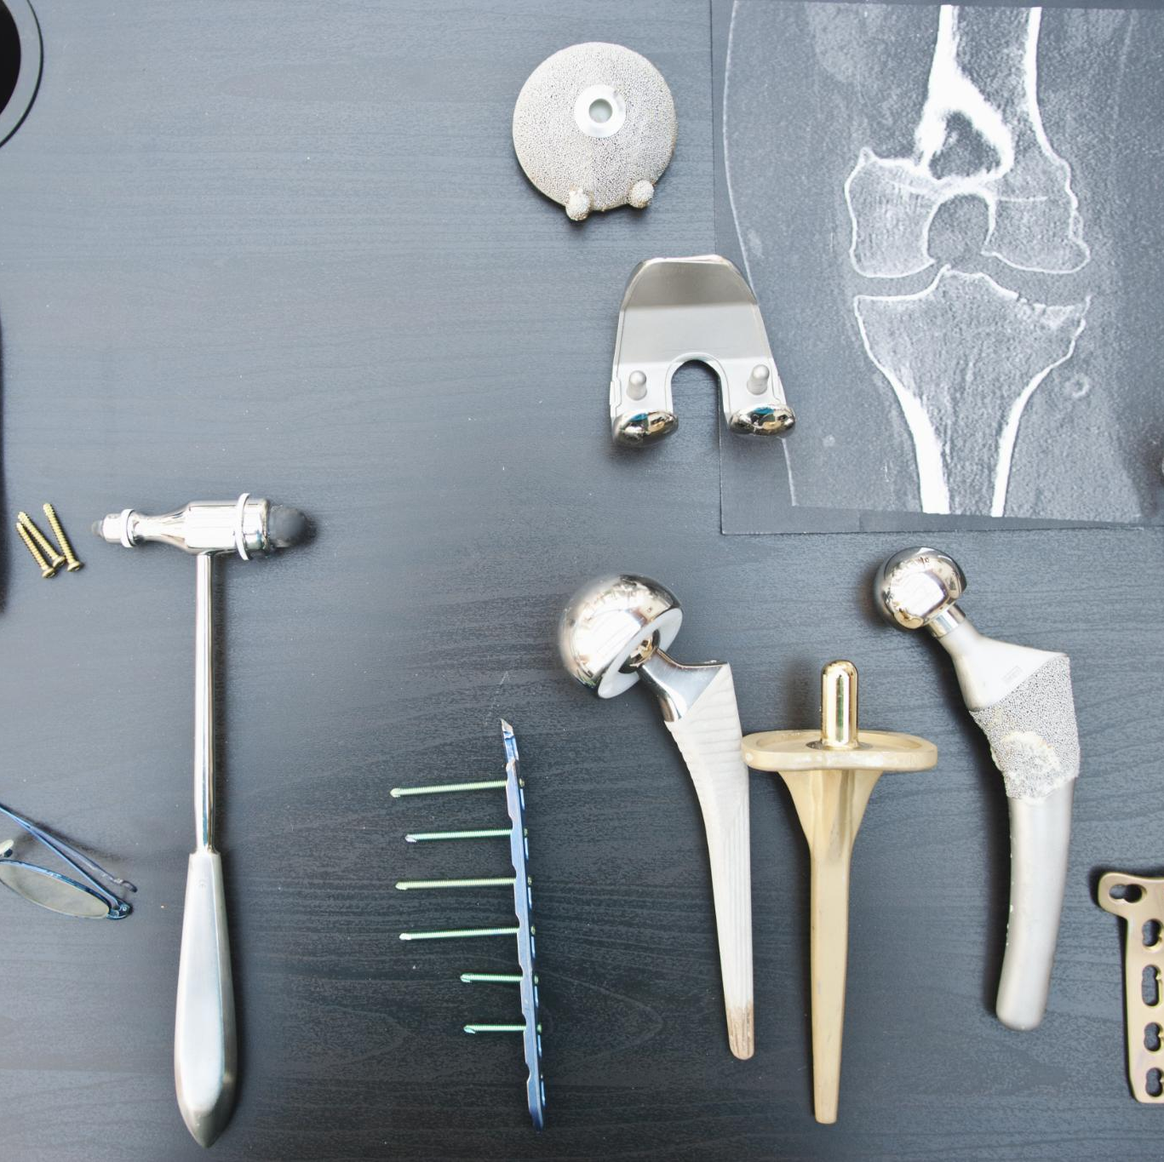
Co–Cr Denture Alloys: Insights
Manufacturing Methods
  Co–Cr alloys are produced by traditional casting or advanced CAD/CAM techniques, providing flexibility, strength, and durability for dental applications.
Clinical Performance
  These alloys demonstrate excellent clinical longevity and minimal corrosion, ensuring reliable performance for denture wearers over time.
Biocompatibility and Safety
  Co–Cr alloys are generally safe and biocompatible but can cause hypersensitivity in some patients. Monitoring is recommended.
Hygiene and Maintenance
  Regular brushing and non-abrasive cleansers are essential to maintain Co–Cr alloy integrity and prevent microbial growth.
Notes:
Image source: Microsoft 365 content library
Co–Cr denture alloys are manufactured via casting or CAD/CAM, offering strength and durability. Clinically, they show excellent performance and longevity, with minimal corrosion. Safety and biocompatibility are generally favorable, though some patients may experience hypersensitivity. Hygiene and cleaning protocols, such as regular brushing and use of non-abrasive cleansers, help maintain alloy integrity and prevent microbial growth.

Slide 6
Search Strategies
Population
Adult patients receiving removable or fixed denture prostheses
Intervention
Cobalt-chromium alloys in dentures (various compositions and manufacturing methods)
Comparison
Alternative materials: titanium, gold alloys
Outcomes
Material properties (corrosion resistance, strength)
Clinical performance (longevity, durability)
Biocompatibility (ion release, safety)
Effects of cleaning protocols on alloy integrity

Slide 7
Search Strategies
Keywords:
Databases:
PubMed
Web of Science
Scopus
Programs:
Zotero
Covidence

Slide 8
Prisma:

Slide 9
Data Presentation:
Direct Quotes

Slide 10
Data Presentations
Discussions
Comparisons

Slide 11
Graphics
Charts

Slide 12
Conclusion

